Slide 1
INT 306 Database Management Systems (DBMS) Lecture 0 ‘ Let’s move toward the better way to store and manage the data’

Slide 2
Course Details
INT-306
Text Book –
DATABASE SYSTEM CONCEPTS by HENRY F. KORTH, ABRAHAM SILBERSCHATZ, S. SUDARSHAN, TATA MCGRAW -HILL EDUCATION.

Slide 3
Marks criteria
Contributor | Marks
Attendance | 5
CA(2 out of 3) | 20
MTE | 25
ETE | 50

Slide 4
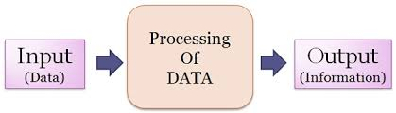
Data and information
Raw material that can be processed by any computing machine is data.
Images, words, numbers , sounds etc. all forms different representations of the data.

Slide 5
Database
A database is actually a place where related piece of information is stored and various operations can be performed on it.
Or we can say database is a shared collection of logically related data in a systematic manner that is stored to meet the requirements of different users of an organization that can be easily accessed.
Database can be maintained manually or through electronic devices such as digital diaries,mobile phones,computers etc.

Slide 6
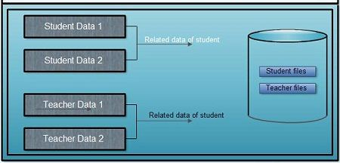
Database

Slide 7
Introduction to DBMS
DBMS=Database Management System
Database+Management+System
In which the database is managed by the system.
Database Management System
Database+Management System
collection of data is a set of program to store &
retrieve the data.

Slide 8
A DBMS is a software(or a collection of programs) that enables users to store modify and extract information from a database as per the requirements.
DBMS is actually a tool that is used to perform any kind of operation on data in database.
Some DBMS examples:
My SQL
Oracle
My SQL server

Slide 9
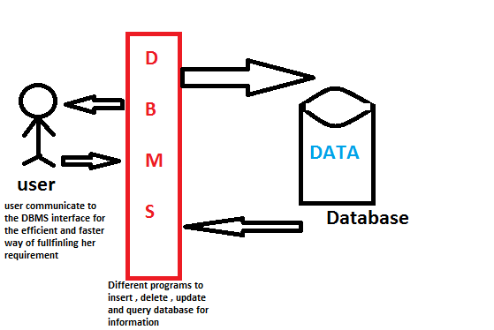
Database Management Systems

Slide 10
Unit 1: Introduction to Databases
purpose of database systems
components of dbms
applications of dbms
three tier dbms architecture
data independence
Database Schema, instance
data modeling
entity relationship model
relational model

Slide 11
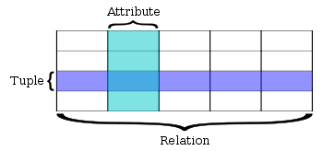
Relational Databases

Slide 12
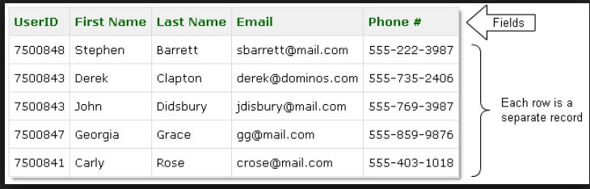
Relational Databases

Slide 13
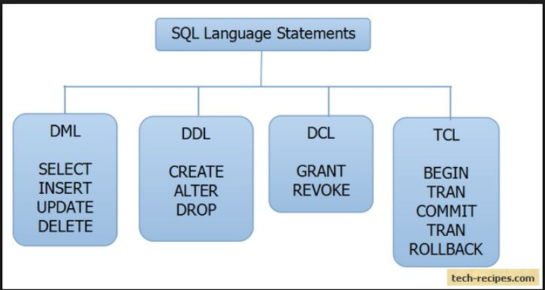
Unit 2: Relational Query Languages

Slide 14
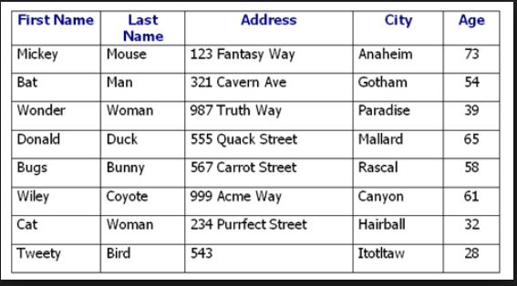
Unit 3: Relational Database Design

Slide 15
Normalization
Normal forms

Slide 16
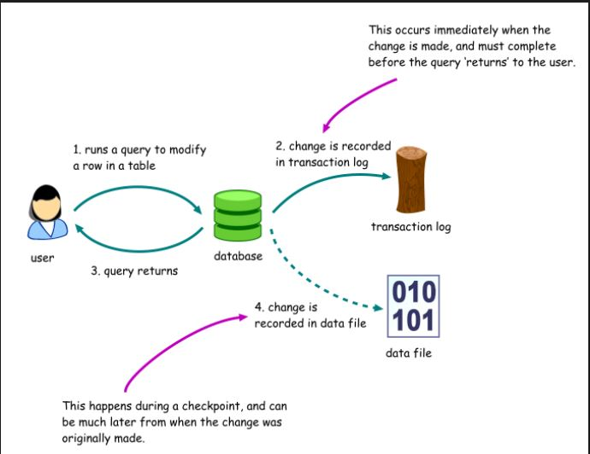
Unit 4: Database Transaction Processing

Slide 17
Unit 5:Programming Constructs in Databases
Cursors
Triggers
exception handling

Slide 18
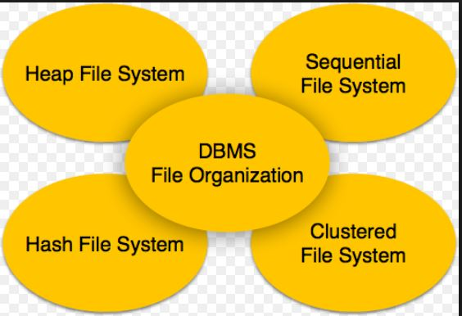
Unit 6: File Organization and Trends in Databases

